Slide 1




PROTOTWIN-PET:
Patient-Specific Deep Learning Models for Dose Verification in Proton Therapy with PET
Pablo Cabrales¹, Víctor V. Onecha³, David G. Izquierdo³, José Manuel Udías^{1,2}, and Joaquín L. Herraiz^{1,2}
¹Grupo de Física Nuclear, EMFTEL & IPARCOS, Universidad Complutense de Madrid, CEI Moncloa, Madrid, Spain
²Instituto de Investigación del Hospital Clínico San Carlos (IdISSC), Madrid, Spain
³Massachusetts General Hospital and Harvard Medical School, Boston, USA

Slide 2
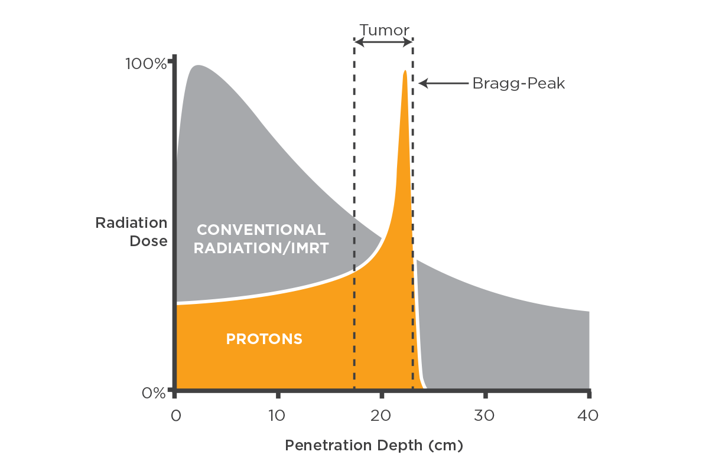
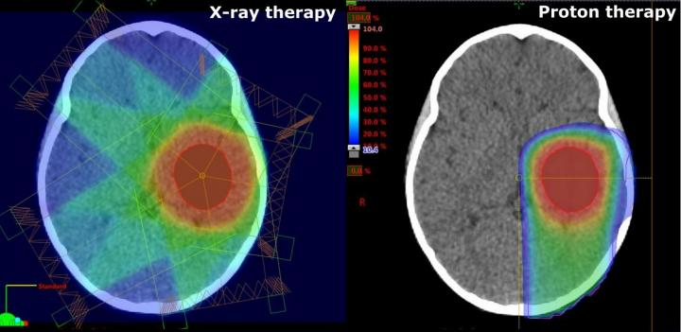
Opportunities and Challenges in Proton Therapy
Protons target tumors more precisely than X-rays: Bragg Peak
Bragg Peak
Spared area
But more sensitive to uncertainties:
patient position, organ motion, physical parameters…
Because protons stop at Bragg Peak (no exit dose, can’t directly verify where radiation (dose) was delivered
→ Positron Emission Tomography (PET)
X-rays
Protons
Notes:
1- We select the energy of the protons such that the bragg peak is at the tumor, SPARING WHAT IS BEHIND
2- The highly localized dose delivery make the treatment more sensitive to uncertainties, radiating what is behind
3- We need to know where the radiation, which is usually called radiation dose, or dose is delivered to know if treatment has gone as planned or if we have damaged healthy tissue and underdosed the tumor. Since radiation therapy treatments are spaced across around 30 sessions, deposition errors in one session can be corrected in following sessions

Slide 3
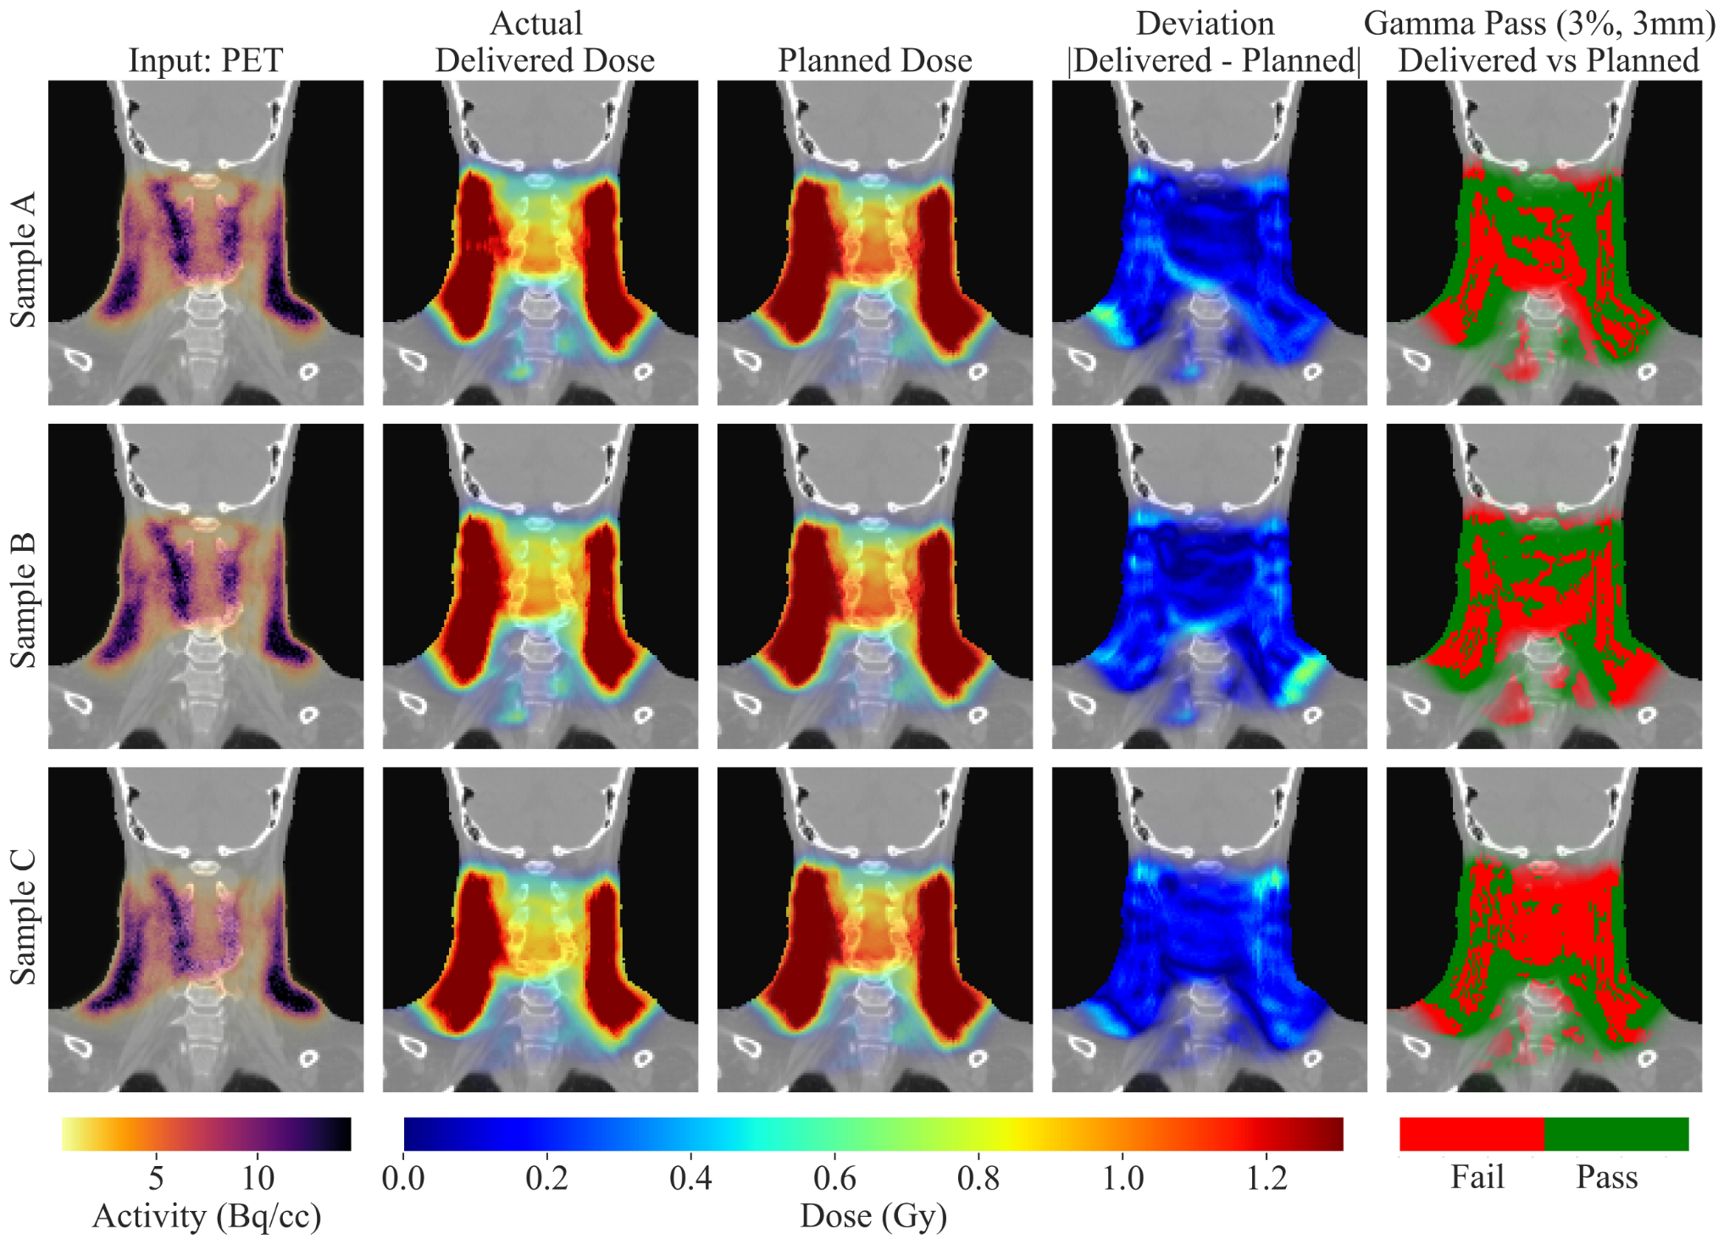

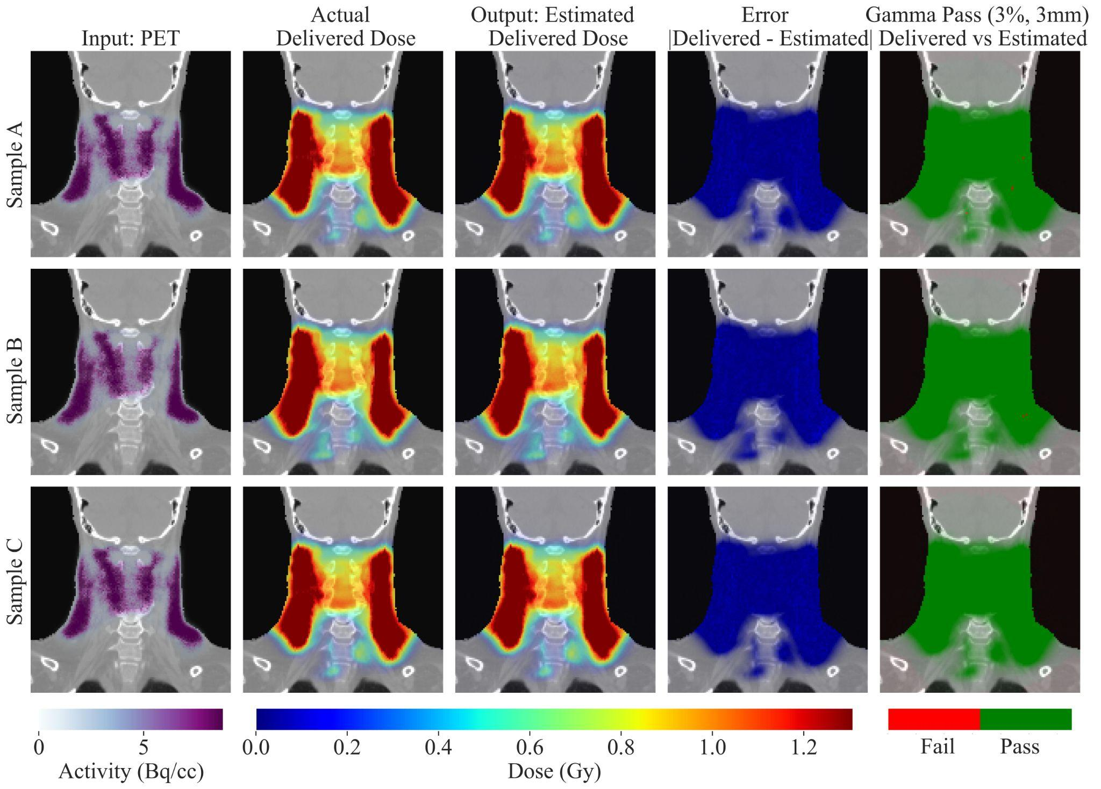
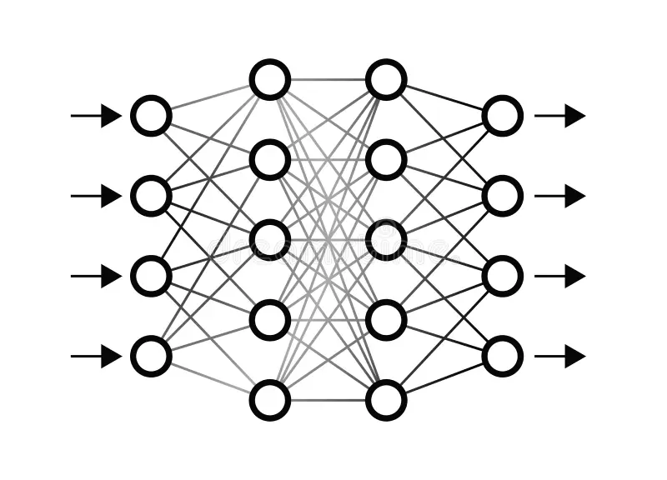

Dose Verification with PET and Limitations
Activated Positron Emitters
Deep Learning
Estimated Radiation Dose
Proton
Beam
PET
1.0 -
10 -
5 -
0.5 -
Bq/cc
Gy
Challenging! Different physical processes, low PET counts and washout (noisy images)
Current approaches (Peng et al., 2023):
Unrealistic PET-dose datasets (bad training data):
PET scan not simulated: Washout, Positron Range, Scanner Model
Unrealistic treatment deviations
Datasets obtained with CPU: too slow for ~24h between CT and first session
Deep learning models are in 1D, or 3D but old or hard to train (GANs)
Notes:
as protons pass through the body, they deposit radiation, which is what we want to know but can’t now directly, but they also activate isotopes that emit positrons.
the conversion from PETto dose is not straightforward because, while dose depositions are related to interactions between protons and the nuclei electrons, destroying the cell dna, PET activations correspond to nuclear interactions, and thus take place at different energies and are not directly correlated. Moreover, positron emitter counts are low and suffer from washout, leading to noisy PET images
the training data is bad and the model will not work in a real situation: unrealistic datasets do not consider effects that will appear in the clinical practice and that our model needs to be shown in training so that it can work in the clinical practice

Slide 4
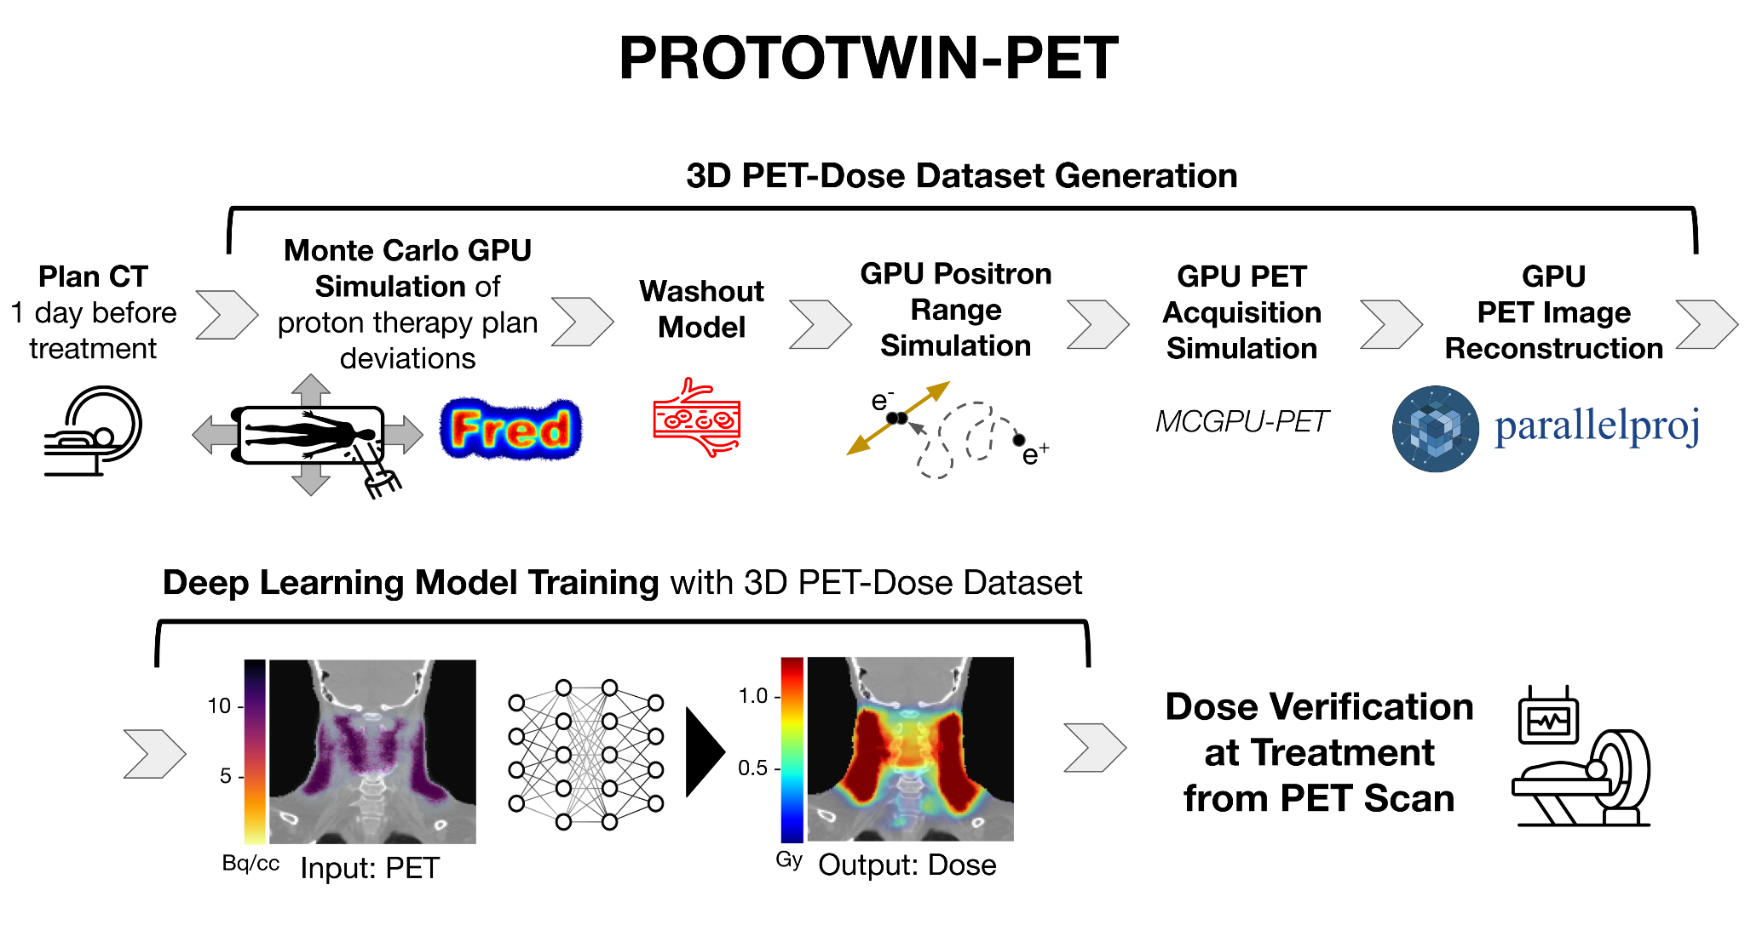
Our solution:
Notes:
prototwin-pet stands for PROTOn therapy digital TWIN models for dose verification with PET

Slide 5
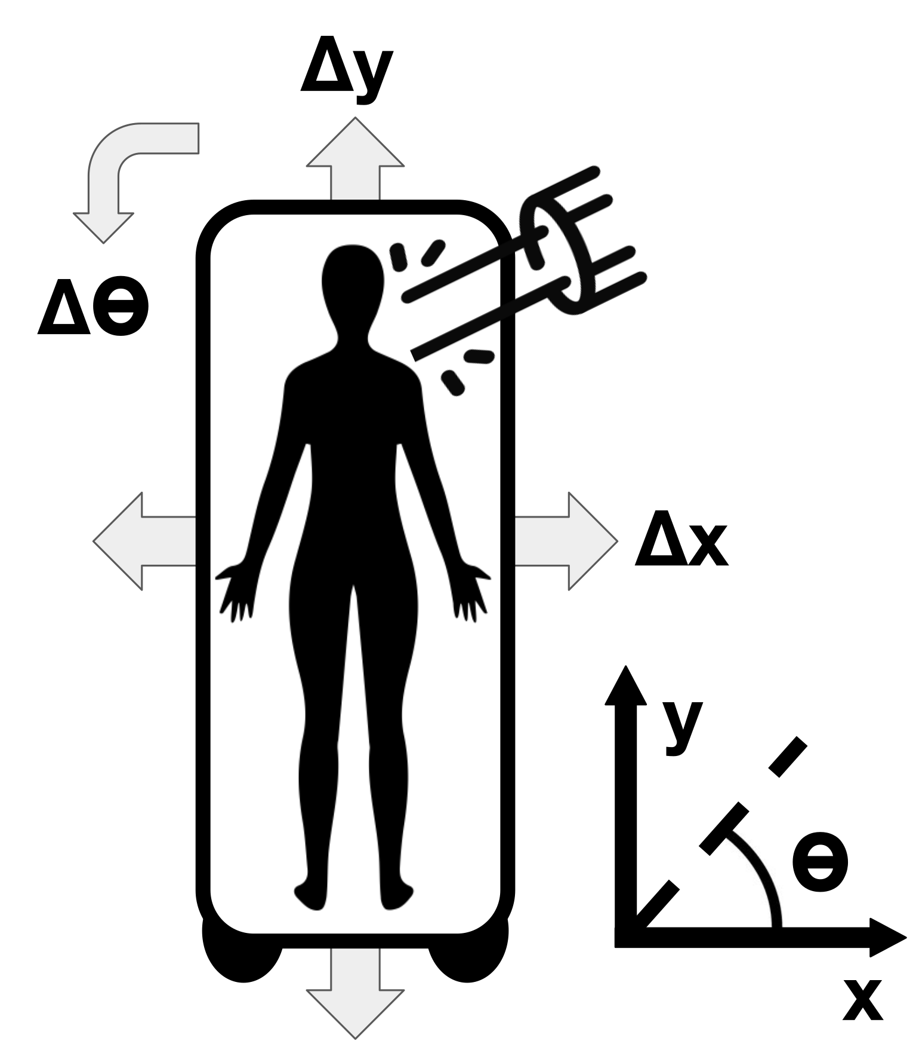
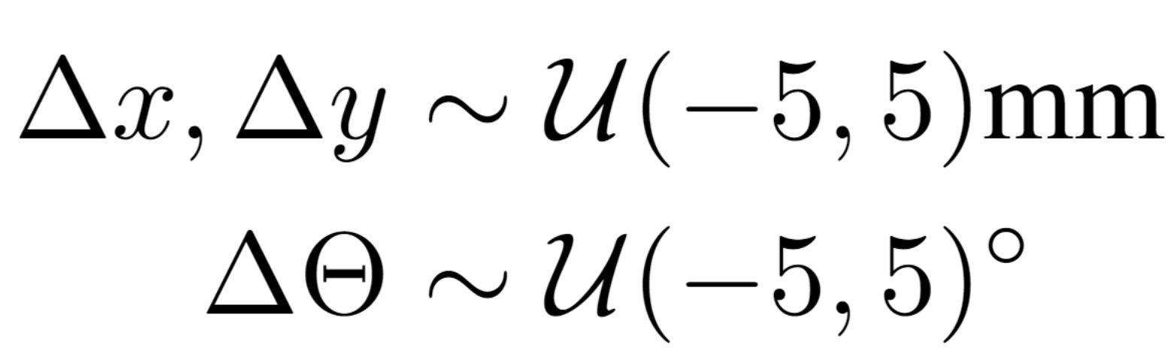
Training Dataset:
Dataset:
160 PET-Dose 3D pairs:
120 training, 20 validation, 20 testing
Approx. 20 hours to generate
128 × 96 × 128 voxels
1.95 x 1.95 x 1.5 mm
Clinically realistic, expected treatment deviations:
Patient positioning
Physical parameters

Slide 6
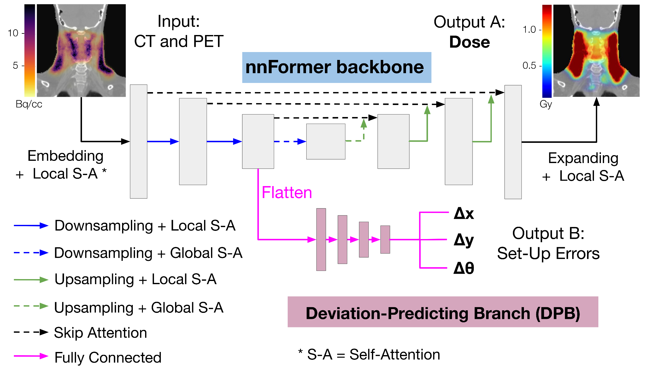
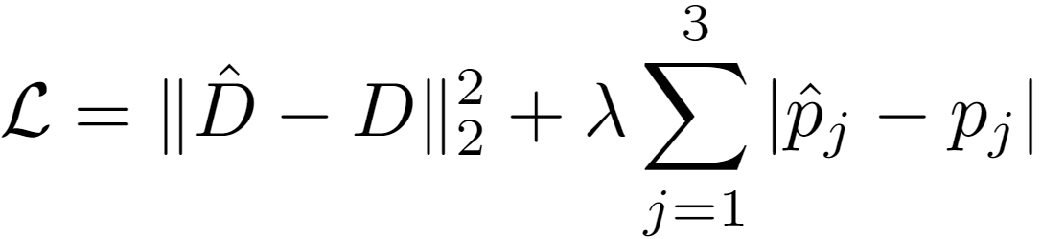
Deep Learning Architecture and Training:
Notes:
lambda is a hyperparameter that was tuned experimentally

Slide 7
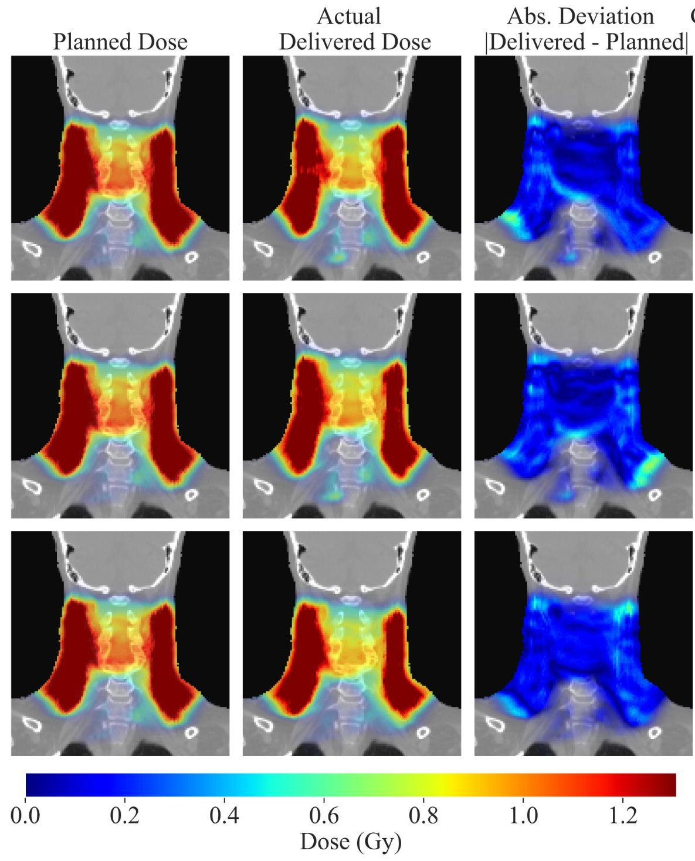
From clinically relevant treatment deviations…
Notes:
but we don’t have the actual delivered dose, we need to estimate it with PET

Slide 8
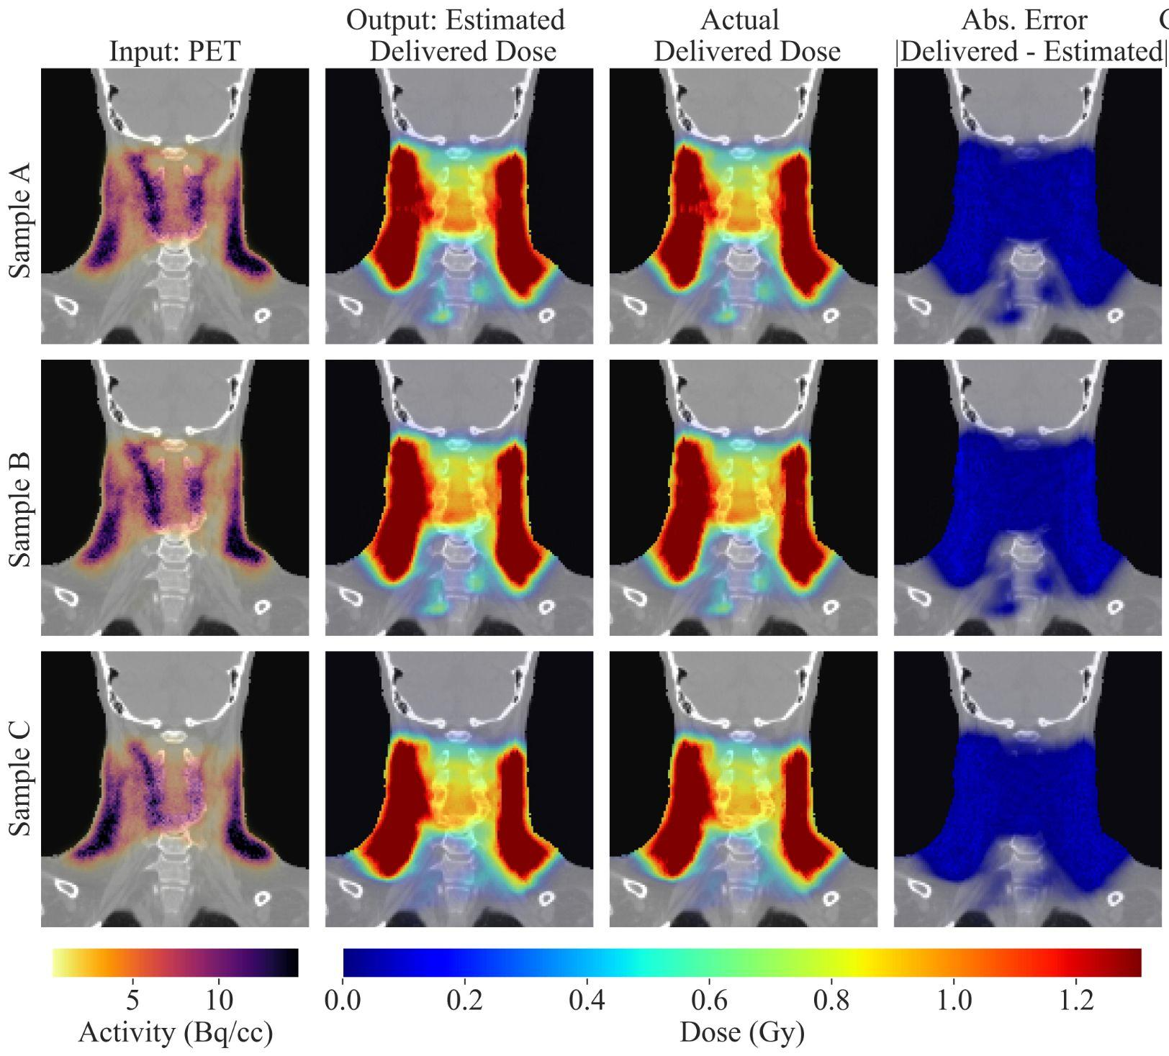
To accurate dose deposition estimation from PET
Model training in
2 hours (500 epochs)
Inference in 30ms

Slide 9
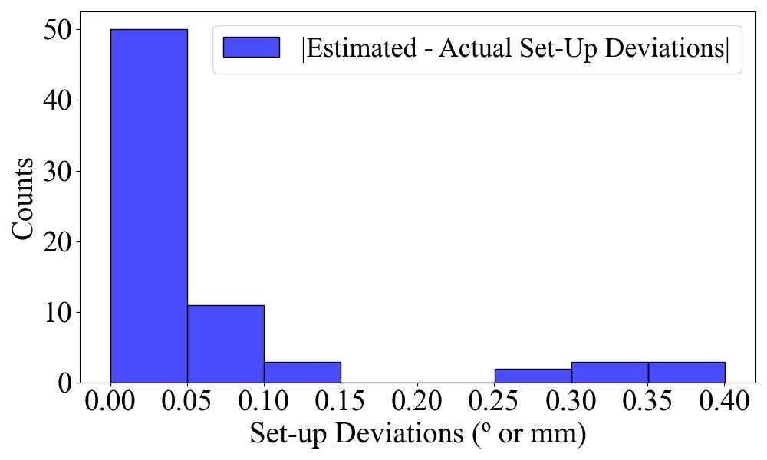
Set-up error detection with submillimetric accuracy
|Δx_{estimated} - Δx_{actual}| = 0.07 ± 0.11 mm
|Δy_{estimated} - Δy_{actual}| = 0.03 ± 0.04 mm
|Δθ_{estimated} - Δθ_{actual}| = 0.08 ± 0.10 º
If Deviation-Predicting Branch starts at bottleneck:
|Δx_{estimated} - Δx_{actual}| = 0.08 ± 0.14 mm
|Δy_{estimated} - Δy_{actual}| = 0.05 ± 0.04 mm
|Δθ_{estimated} - Δθ_{actual}| = 0.10 ± 0.16 º
Notes:
Placing the DPB at earlier encoder layers introduces excessive complexity and parameters into our model, while not utilizing the features already extracted in the previous encoder layers which are also used to reconstruct the dose image.

Slide 10
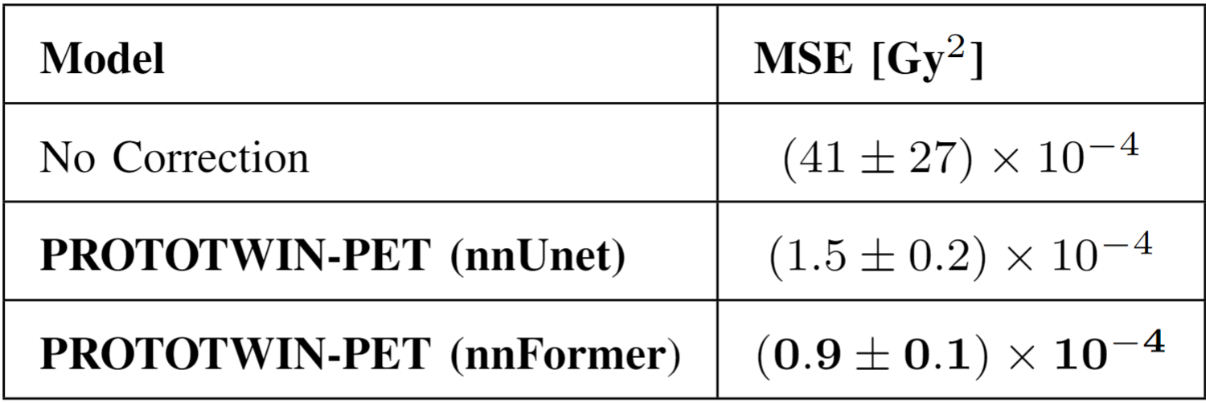
nnUnet vs nnFormer:
Might indicate the potential of transformers in Monte Carlo simulation images

Slide 11
Conclusions
Computational advances (GPU tools) and deep learning versatility (nnFormer + DPB) leveraged to accurately verify dose and estimate set-up errors from PET scan → adapt treatment in following sessions
Uncertainties remain (nuclear interaction cross-sections, PET-CT registration, diffusion in washout)
Verification in real patients is key
Step toward dose verification for avoiding damage to healthy tissue and fully targeting tumor, exploiting potential of proton therapy accuracy

Slide 12






Acknowledgements
Prototwin Project (TED2021-130592B-I00) funded by MCIN/AEI/10.13039/501100011033 and by the European Union NextGenerationEU/PRTR.
Fascina Project (PID2021-126998OB-I00) and 3PET Project (PDC2022-133057-I00) funded by MCIN/AEI/10.13039/501100011033 and by the European Union NextGenerationEU/PRTR.
Tartaglia Project (MIA.2021.M02.0005) - Ministerio de Asuntos Económicos y Transformación Digital, financiado con fondos del Plan de Recuperación, Resiliencia y Transformación de la Unión Europea a través de los fondos Next Generation EU. TARTAGLIA está enmarcado dentro del programa Misiones de I+D en Inteligencia Artificial de la agenda España Digital 2025 y de la Estrategia Nacional de Inteligencia Artificial.
Pablo Cabrales was also funded by Complutense University Predoctoral Fellowship and Santander Bank

Slide 13
Thank you! Questions?
Pablo Cabrales Miró-Granada (pcabrale@ucm.es)
Grupo de Física Nuclear @ UCM

Slide 14
Additional material

Slide 15
Deep Learning Architecture and Training:
Protons leave correlated effect through image:
CNN + Vision Transformers (nnFormer) better than
pure CNN (nnUnet) ?
Images are 3D and large (128⨯96x128) for GPU
Batch size = 1, accumulated gradients for stability
Optimizer choice is key for fast and accurate convergence:
AdamW with initial learning rate of 0.001 and cosine scheduling
Notes:
nnFormer introduces transformers at different stages and scales of the network

